Slide 1
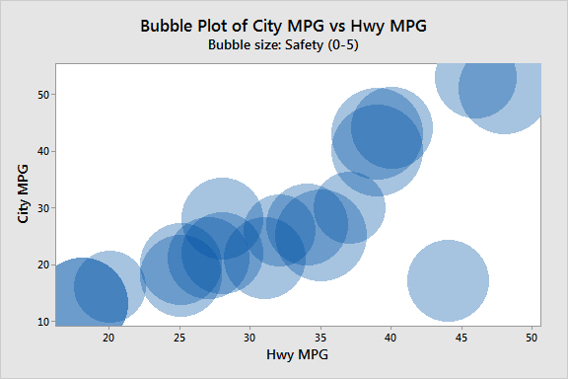
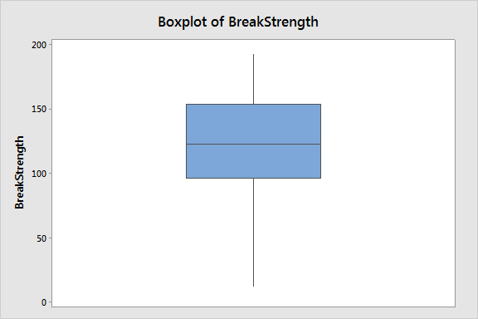
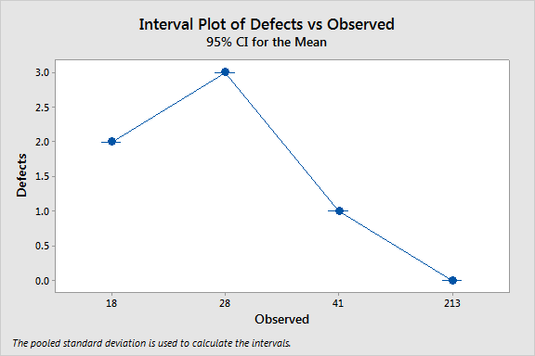
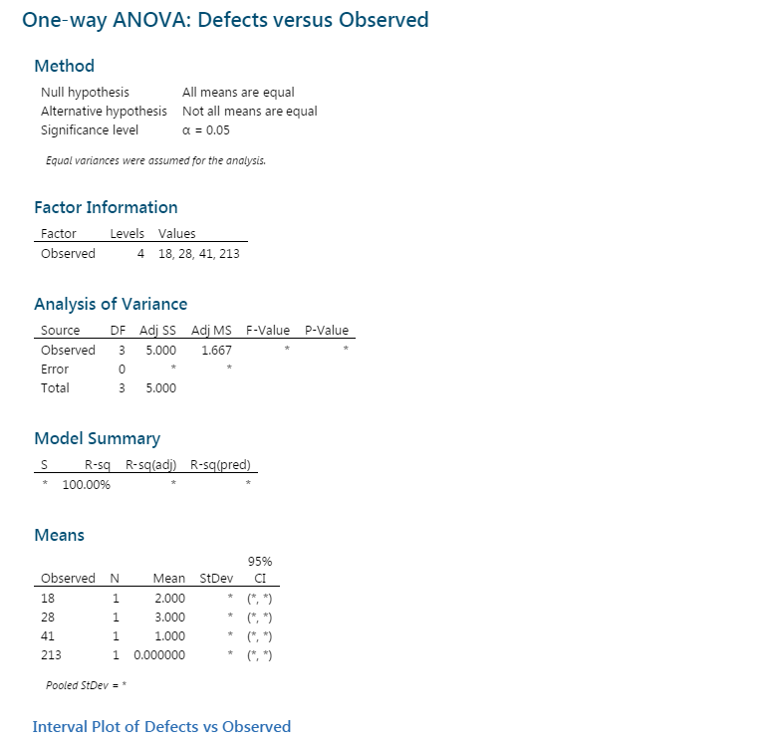
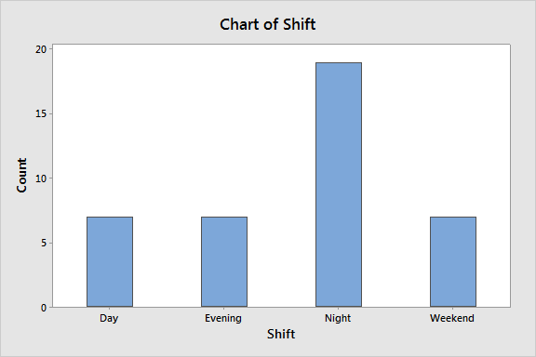
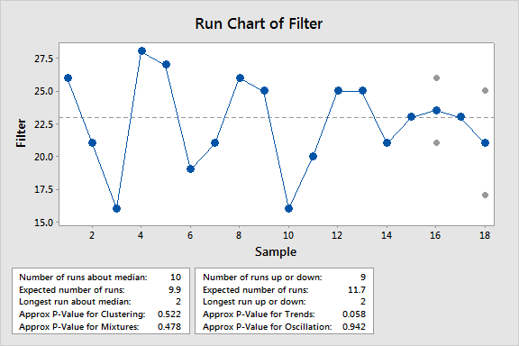
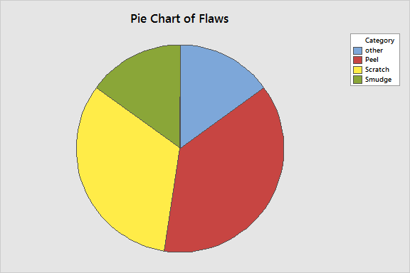
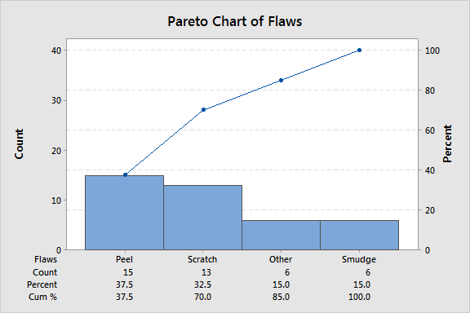
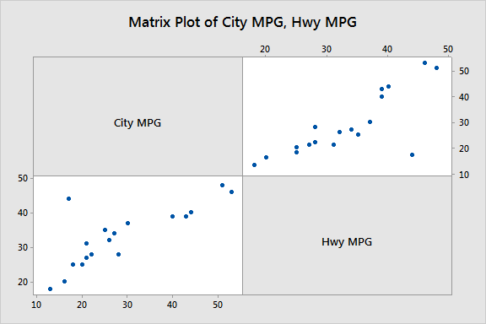
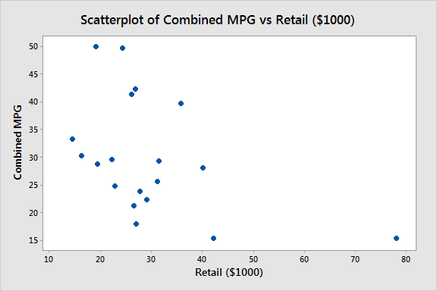
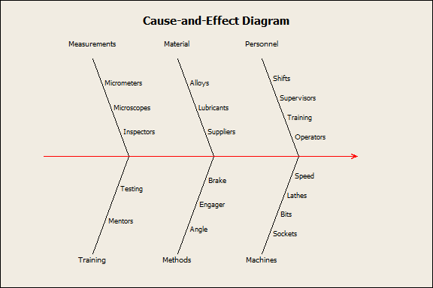
DATA MINNING USING MINITAB
Zareen Tasnim Safa
Roll: 201636044
Departament: IPE-01
Course: IPE-314
Bubble Plot
Box Plot
Anova
Data Modelling
Bar Chart
Run Chart
Pie Chart
Pareto Chart
Matrix Plot
Dataset
Filter | Membrane | Open Cup | Badge
26 | 44 | 36 | 21
21 | 33 | 34 | 23
16 | 36 | 33 | 27
28 | 46 | 29 | 29
27 | 25 | 30 | 24
19 | 32 | 36 | 26
21 | 33 | 28 | 27
26 | 22 | 34 | 26
25 | 30 | 34 | 24
16 | 26 | 33 | 25
Scatter Plot
Cause & Effect
Summary
This is a visual representation of exploratory data analyse using Minitab software. Minitab is a general-purpose statistical software package designed for easy interactive use. Minitab is well suited for instructional applications, but is also powerful enough to be used as a primary tool for analysing research data. Here 10 types of graph is given using minitab functions.

